Slide 1
IOT IN HEALTH CARE
Group No - 13
Guided By – Deepali Despande
18 - Abhijit Gawai
29 - Shyam Kawale
43 - Nishant Bhat
50 - Bhargav Pawar
55 - S. Abhishek

Slide 2
CONTENT
What IOT?
Why IOT?
Remote Patient Monitoring
Continuous Glucose Monitoring System
Ingestible sensors
Robotic surgery

Slide 3
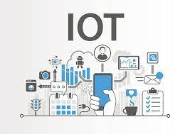
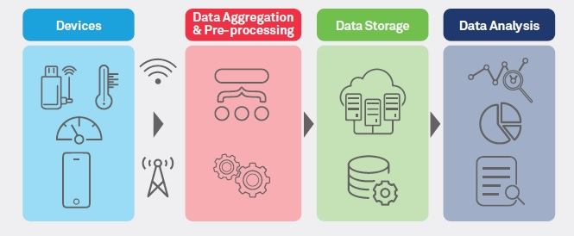
WHAT IS IOT?
IOT refers to the ever-growing network of physical objects that feature an IP address for internet connectivity, and the communication that occurs between these objects and other internet enabled devices and systems.
In simple words, IOT is an ecosystem of connected physical objects that are accessible through the internet.
E.g. A car that automatically the wear and tear and schedules a maintenance session or a train that dynamically calculates arrival times.

Slide 4
WHY IOT?
More data means better decisions.
Ability to track and monitor things.
Lighten the workload with automation.
Increase efficiency by saving money and resources.
Better quality of life.

Slide 5
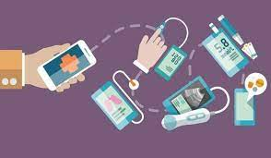

REMOTE PATIENT MONITORING
Modern medicine would not be called ‘modern’ without the contribution of technology to it.
Technology in Healthcare development is not only for lab work.
Remote patient monitoring (RPM) is a technology to enable monitoring of patients outside of conventional clinical settings, such as in the home or in a remote area, which may increase access to care and decrease healthcare delivery costs.

Slide 6
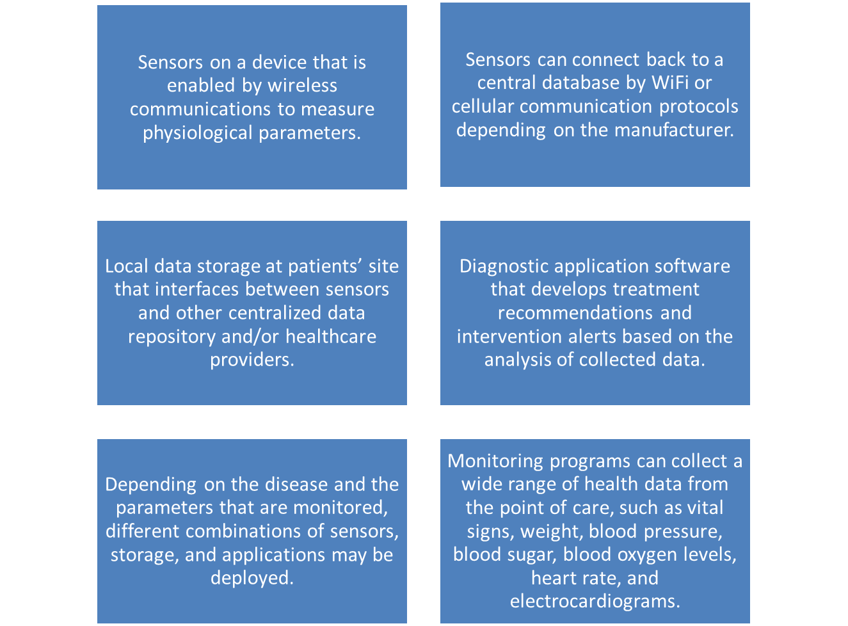
TECHNOLOGICAL COMPONENTS

Slide 7

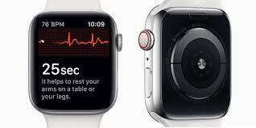
USE OF RPM IN INDIA ?
“Precaution is always better than cure” Apple watch that monitors an individual person’s health and fitness. This watch collects data such as a person’s heart rate, step counter, sleep cycle, activity level, breathing rate, blood pressure, etc.
Family Doctor.
YSR Telemedicine.
With the COVID-19 pandemic, health systems rapidly adopted remote patient monitoring technology. Within the next 5 years, the RPM market is expected to double in size.

Slide 8
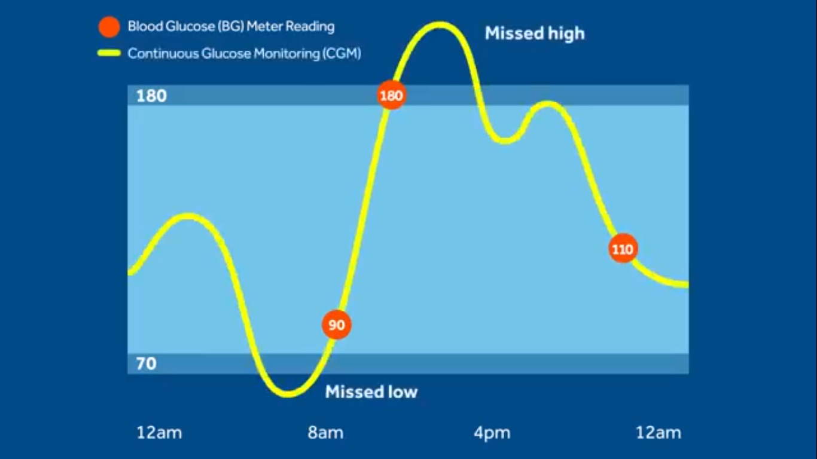
CONTINUOUS GLUCOSE MONITORING SYSTEM
Used for Continuous Glucose level measurement for Diabetic person.
According to WHO 2020 report, number of diabetic people are over 422 millions and over 2.5 million died.
NO permanent cure for Diabetes. So, measure glucose level continuously and take corrective actions(like healthy diet, physical exercise, medications etc.).
Using IOT based CGM we can get a fuller picture over person’s
glucose level.

Slide 9
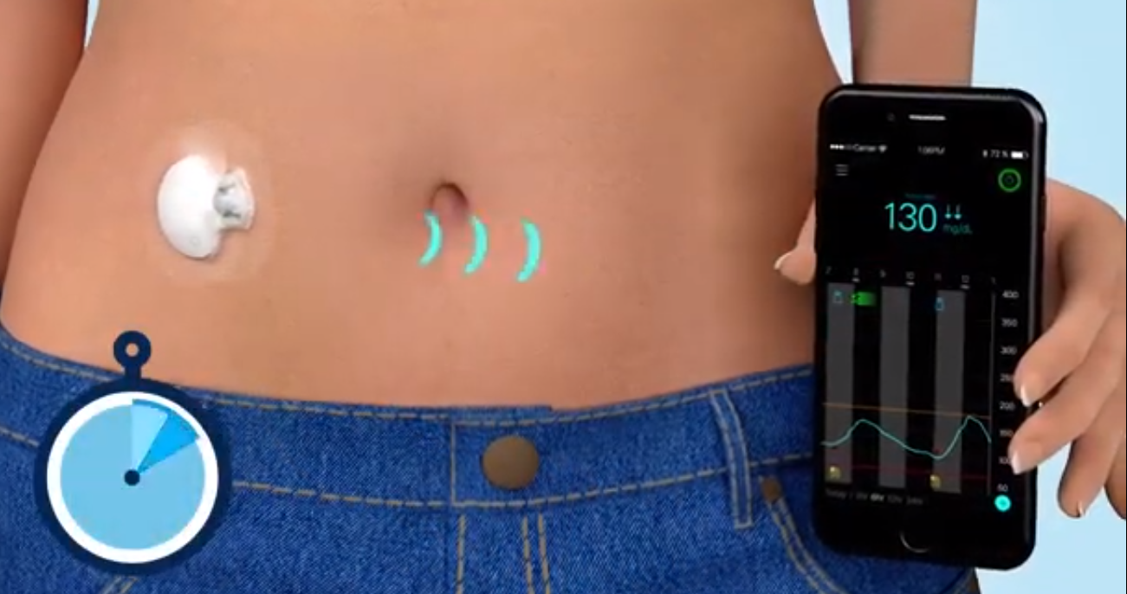
COMPONENTS OF IOT BASED CGM
Components of IOT based CGM are:
Sensors
Transmittor
Monitor(Mobile device)

Slide 10
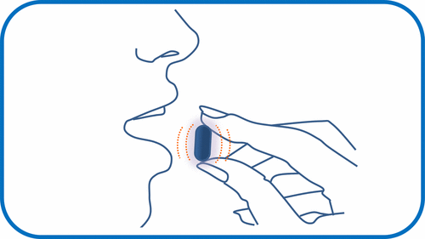
INGESTIBLE SENSORS
Pill-sized electronics that ping your smartphone with data after you pop and swallow
Noninvasive
Sends data about pH, temperature, pressure and gastrointestinal bleeding

Slide 11
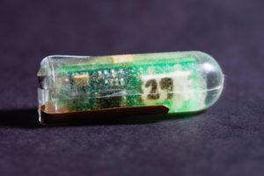
POWER SUPPLY IN INGESTIBLE SENSORS
Citric acid in stomach allows a small electrical current to flow ingestible sensor has zinc and copper electrodes
The stomach acid receives the zinc ions and powers the voltaic current
Produces enough energy to power a commercial temperature sensor and a 900 mHz transmitter

Slide 12
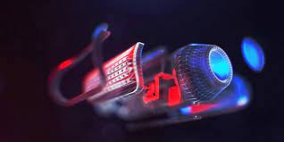
FUTURE DIRECTIONS
A psychological challenge
massive expenditures linked to product
require invention of new integrated technologies
More information can be obtained
ingestible sensors are the future of our health.

Slide 13
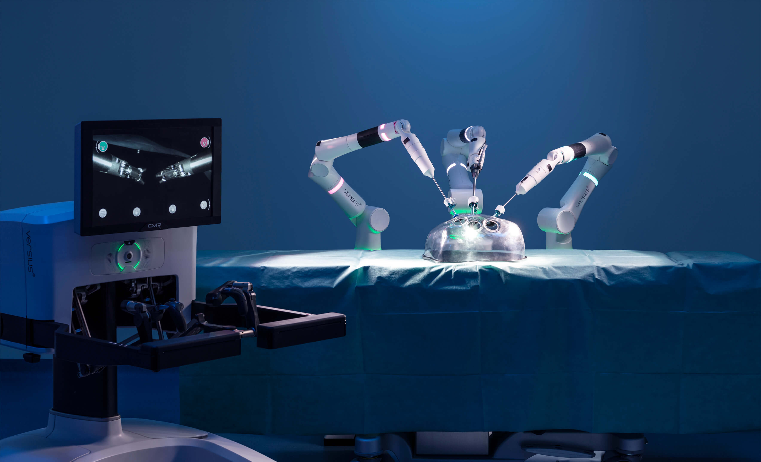
ROBOTIC SURGERY
Robotic surgeries performed by small IoT devices can reduce the size of incisions required to perform surgery, leading to a less invasive process, and faster healing for patients.
These devices must be small enough and reliable enough to perform surgeries with minimal disruption.

Slide 14
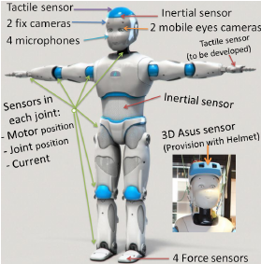
SENSORS USED
Camera
Light sensor
Proximity sensor
Sound sensor
Temperature sensor
Acceleration Sensor

Slide 15
REFRENCES
https://en.wikipedia.org/wiki/Remote_patient_monitoring
https://tejas-kachare18.medium.com/ai-in-healthcare-36c1b4f136ee
https://www.ncbi.nlm.nih.gov/pmc/articles/PMC5191073/#:~:text=CGM%20sensors%20are%20composed%20of,and%20is%20aimed%20at%20transmitting
https://www.sciencedirect.com/science/article/pii/S1877050917310281
http://ijsrcseit.com/paper/CSEIT1722231.pdf
https://ordr.net/article/iot-healthcare-examples/
https://pubs.acs.org/doi/10.1021/acssensors.7b00045

